Slide 1
JavaScript

Slide 2
Why Study JavaScript?
JavaScript is one of the 3 languages all web developers must learn:
HTML to define the content of web pages
CSS to specify the layout of web pages
JavaScript to program the behavior of web pages
JavaScript accepts both double and single quotes:

Slide 3
Can Change HTML Content
<html>
<body>
<h2>What Can JavaScript Do?</h2>
<p id="demo">JavaScript can change HTML content.</p>
<button type="button" onclick="document.getElementById('demo').innerHTML = 'Hello JavaScript!'">Click Me!</button>
</body>
</html>

Slide 4
One of many JavaScript HTML methods is getElementById()
This example uses the method to "find" an HTML element (with id="demo") and changes the element content (innerHTML) to "Hello JavaScript":

Slide 5
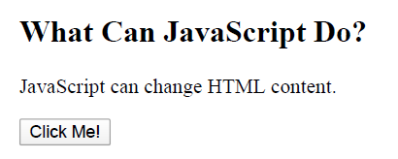

Slide 6
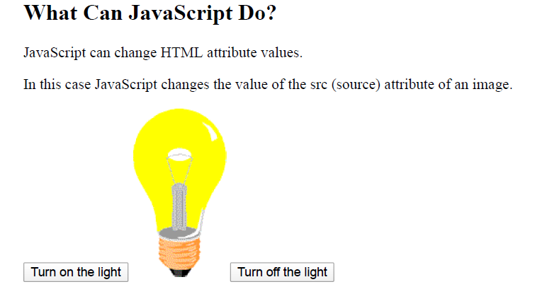
Can Change HTML Attribute Values
In this example JavaScript changes the value of the src (source) attribute of an <img> tag:

Slide 7
<html>
<body>
<h2>What Can JavaScript Do?</h2>
<p>JavaScript can change HTML attribute values.</p>
<p>In this case JavaScript changes the value of the src (source) attribute of an image.</p>
<button onclick="document.getElementById('myImage').src='pic_bulbon.gif'">Turn on the light</button>
<img id="myImage" src="pic_bulboff.gif" style="width:100px">
<button onclick="document.getElementById('myImage').src='pic_bulboff.gif'">Turn off the light</button>
</body>
</html>

Slide 8
Can Change HTML Styles (CSS)
<html>
<body>
<h2>What Can JavaScript Do?</h2>
<p id="demo">JavaScript can change the style of an HTML element.</p>
<button type="button" onclick="document.getElementById('demo').style.fontSize='35px'">Click Me!</button>
</body>
</html>

Slide 9
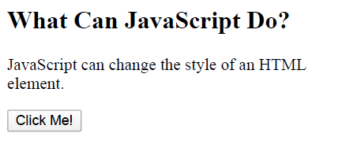

Slide 10
Can Hide HTML Elements
<html>
<body>
<h2>What Can JavaScript Do?</h2>
<p id="demo">JavaScript can hide HTML elements.</p>
<button type="button" onclick="document.getElementById('demo').style.display='none'">Click Me!</button>
</body>
</html>

Slide 11
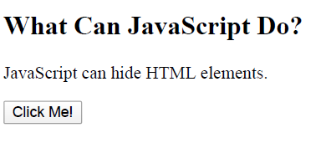

Slide 12
Statements
var x, y, z; // Statement 1 x = 5; // Statement 2 y = 6; // Statement 3 z = x + y; // Statement 4

Slide 13
<html>
<body>
<h2>JavaScript Statements</h2>
<p>A <b>JavaScript program</b> is a list of <b>statements</b> to be executed by a computer.</p>
<p id="demo"></p>

Slide 14
<script>
var x, y, z; // Statement 1
x = 5; // Statement 2
y = 6; // Statement 3
z = x + y; // Statement 4
document.getElementById("demo").innerHTML =
"The value of z is " + z + ".";
</script>
</body>
</html>

Slide 15
Keywords
Keyword | Description
break | Terminates a switch or a loop
continue | Jumps out of a loop and starts at the top
debugger | Stops the execution of JavaScript, and calls (if available) the debugging function
do ... while | Executes a block of statements, and repeats the block, while a condition is true
for | Marks a block of statements to be executed, as long as a condition is true
function | Declares a function
if ... else | Marks a block of statements to be executed, depending on a condition
return | Exits a function
switch | Marks a block of statements to be executed, depending on different cases
try ... catch | Implements error handling to a block of statements
var | Declares a variable

Slide 16
Syntax
var x, y, z; // How to declare variables x = 5; y = 6; // How to assign values z = x + y; // How to compute values
Numbers are written with or without decimals:
10.50 1001
Strings are text, written within double or single quotes:
"John Doe" 'John Doe'

Slide 17
Variables
var keyword to declare variables.
An equal sign is used to assign values to variables
JavaScript Operators
JavaScript uses arithmetic operators ( + - * / ) to compute values:(5 + 6) * 10
Expressions
x * 10

Slide 18
Identifiers
identifiers are used to name variables (and keywords, and functions, and labels).
the first character must be a letter, or an underscore (_), or a dollar sign ($)
Subsequent characters may be letters, digits, underscores, or dollar signs.
Case Sensitive
All JavaScript identifiers are case sensitive.

Slide 19
Variables
variables are containers for storing data values.
In this example, x, y, and z, are variables:
var x = 5; var y = 6; var z = x + y;

Slide 20
<html>
<body>
<h2>JavaScript Variables</h2>
<p id="demo"></p>
<script>
var price1 = 5;
var price2 = 6;
var total = price1 + price2;
document.getElementById("demo").innerHTML =
"The total is: " + total;
</script>
</body>
</html>

Slide 21
Data Types
Numbers are written without quotes.
If you put a number in quotes, it will be treated as a text string.
var pi = 3.14; var person = "John Doe"; var answer = 'Yes I am!';

Slide 22
One Statement, Many Variables
<html>
<body>
<h2>JavaScript Variables</h2>
<p>You can declare many variables in one statement.</p>
<p id="demo"></p>
<script>
var person = "John Doe", carName = "Volvo", price = 200;
document.getElementById("demo").innerHTML = carName;
</script>
</body>
</html>

